Slide 1
Immersive Rigging and Skinning in Virtual Reality Environments

Slide 2
Tasks
Basic user interface
Create and manipulate bones for a given mesh
Skinning of a mesh with the created skeleton
Visualizing the skinned mesh
Record users movement
Recording, saving animations
Creating multiple views
Evaluation of the quality of the mocap
Optimization of the IK algorithm

Slide 3
1) Basic user interface

Slide 4
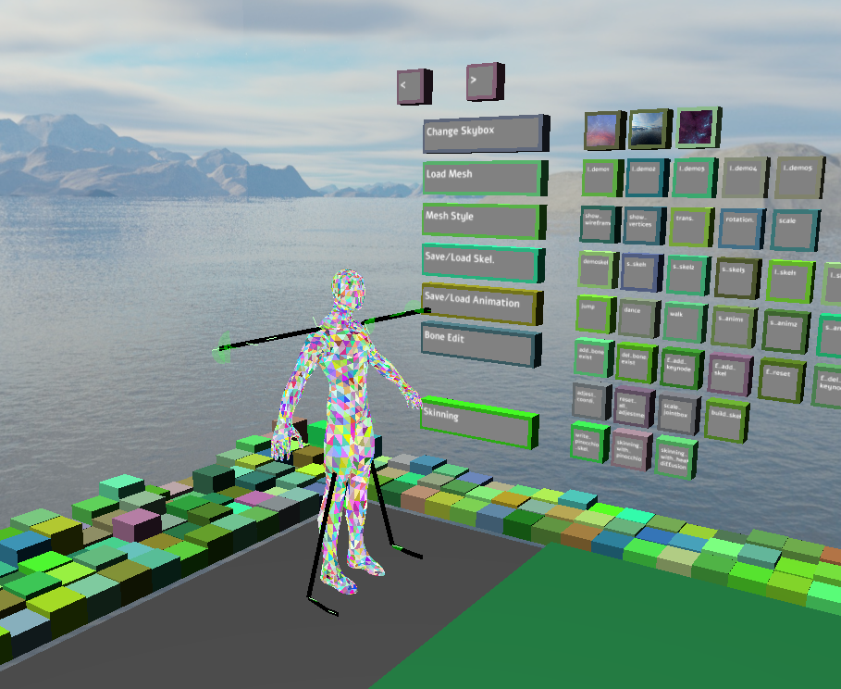
Basic user interface
1) The „BoxGui“
A flexible and extensible yet simple solution for interaction. Almost all kinds of widgets are supported. Buttons can easily be managed into groups.
There is a “boxgui_button” class to manage the properties of the buttons. In a header file called “BoxGui.h”.
Visual feedback provided when intersection happens.
But can only support a few words on each button, which makes a little bit hard for users to know the functionalities.
Buttons are arranged on a virtual wall. They are assigned to random colors.

Slide 5
2) Create and manipulate bones for a given mesh

Slide 6
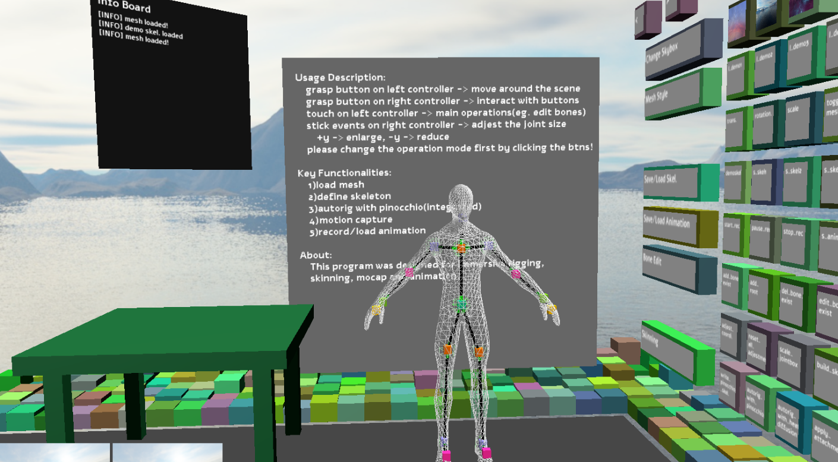
Create and manipulate bones for a given mesh
2.1) Render A Given Mesh
A custom mesh renderer is implemented. It contains a vertex shader, a geometry shader, a fragment shader, and some c++ codes to upload/ update data. E.g. bone attachment matrices, model view matrix and some Boolean variables. The mesh can thus be adjusted according to bone movement.
Different modes are present. One can render the given mesh in one of the following modes: transparent mode, wireframe mode and with back face culling.
The view from the initial pose, and the mesh is rendered in wireframe mode.

Slide 7
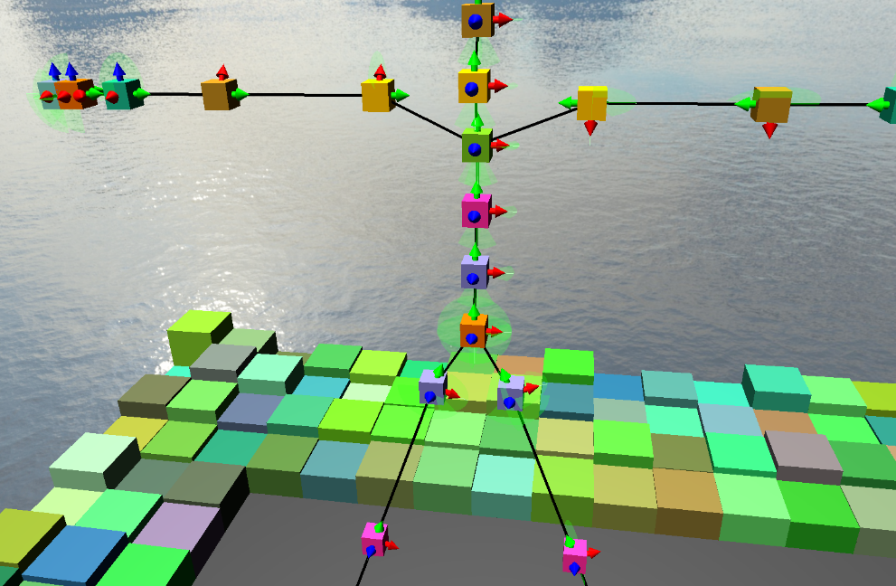
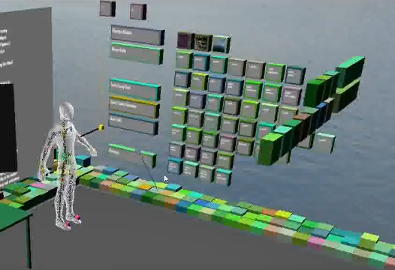
Create and manipulate bones for a given mesh
2.2) Modifications to An Existing Skeleton
A load of a predefined skeleton from disk is supported. That means one can continually refine a skeleton in a simple way.
It is quite flexible that skeletons can be defined for a given mesh in any shape.
One can add, delete and move the selected bone.

Slide 8
3) Skinning of a mesh with the created skeleton

Slide 9
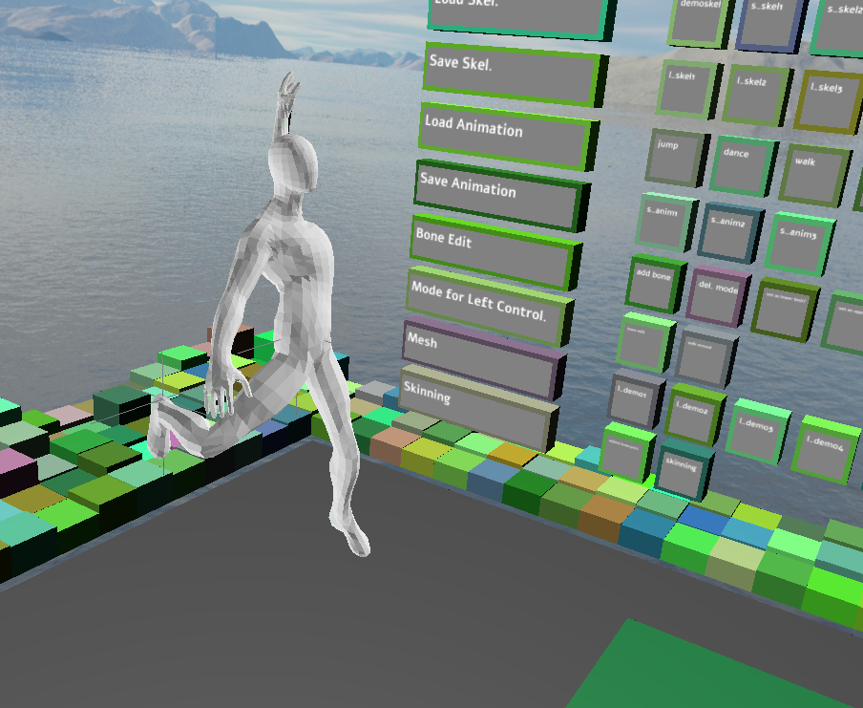
Skinning of a mesh with the created skeleton
3) Skinning With Pinocchio Library
When rigging is finished, a skeleton is defined and transformed to a special format which can be feed into Pinocchio.
The attachment data for bones is available as output file. We have to load it explicitly in the VR scene, by clicking the button.
As the skeleton is defined according to the given mesh directly, we can assume that it will fit the mesh well. Thus a custom skinning tool may be a better choice.
The given mesh can be adjusted according to the skeleton. Which provides an animation effect. Here we take the spiderman as an example.

Slide 10
4) Visualizing the skinned mesh

Slide 11
Visualizing the skinned mesh
4) Visualizing The Skinned Mesh
We can visualize a skinned mesh by varying the position/ direction of individual bones.
Or different color can be used to render individual bones depends on the value it takes. (bone weights)
The skinned mesh can be visualized in more than those two ways.

Slide 12
5) Record users movement with ik

Slide 13
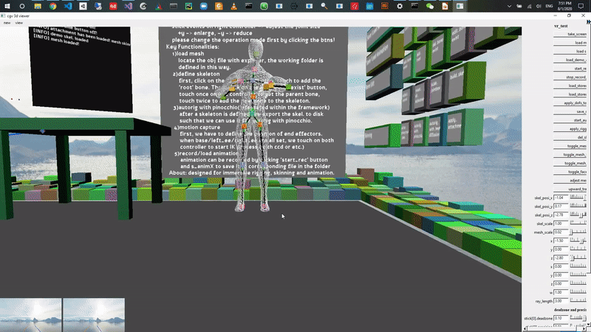
Record users movement with ik
5) Record Users Movement with IK
To capture the user movements in VR, we can use the positions of the controllers as well as the position of the headset. (Or other trackables) The skeleton of the character can be adjusted accordingly with help of IK algorithm.
We may not get an accurate result, But an acceptable result of the motion can be captured without special equipments.
Which is suitable for the case of VR games and some other similar applications.
A acceptable result can be acquired with minimal effort.

Slide 14
Record users movement with ik
5) Record Users Movement with IK
To support IK algorithm with multiple targets, the most intuitive solution is to calculate IK chains two times with two different target positions.
Such a solution can be simplified and improved in future work.
Better IK algorithms can be easily involved in this way.

Slide 15
6) Recording, saving animations

Slide 16
Recording, saving animations
6) Recording, Saving Animations
Animation can be recorded frame by frame. Each frame contains a list of bone dofs.
The currently implemented animation assumes that the local frame is aligned to the world frame. Further work will support the other cases.
This can be done at a framerate of 60Hz. (Or lower) The Output is a file with .anim extension.
Animations can be loaded and played with help of Gui buttons in the scene.

Slide 17
7) Creating multiple views

Slide 18
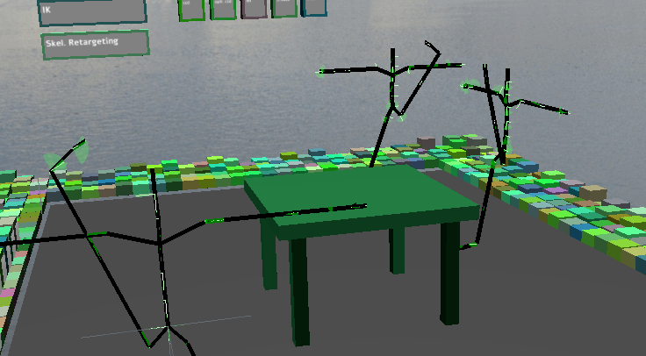
Creating multiple views
7) Creating Multiple Views
To support mirror effect, multiple skeletons are imported to the scene. As can be seen on right side.
One main skeleton can be controlled by user and the other two imitates it.
Essentially, just iterate all bones of the other two skeleton and assign the dofs the same as the one we want to initate.
Multiple skeletons

Slide 19
8) Evaluation of the mocap scheme

Slide 20
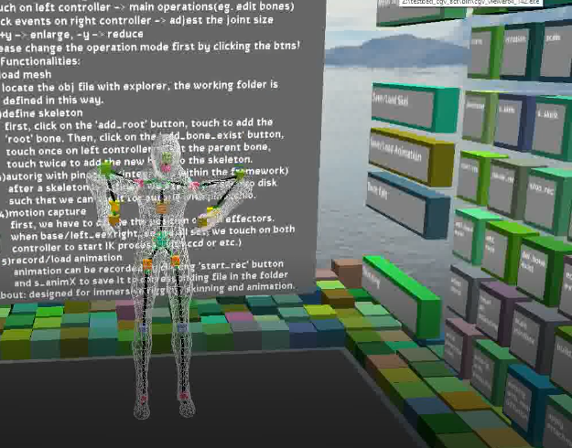
Evaluation of the quality of the mocap
8.1) Evaluation of The Quality Of The Mocap
As the range of the dofs of the bones are not adjusted yet, the result may looks unnatural now.
Further more, such a motion capture scheme does not guarantee the accuracy. As IK problems are always ill-posed.(no solution in range or many solutions exist)
IK based Mocap

Slide 21
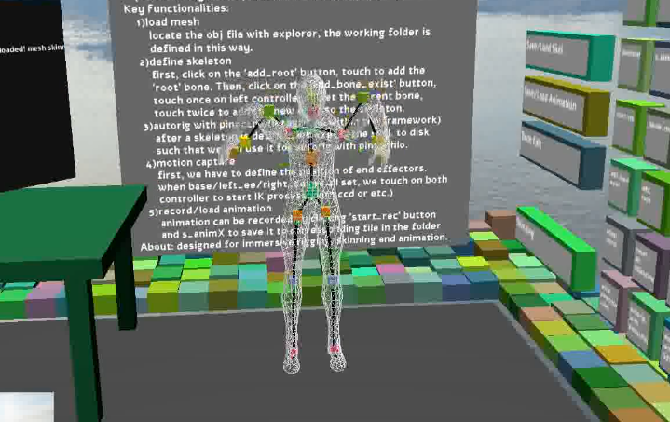
Evaluation of the stability of the mocap
8.2) Evaluation of The Stability Of The Mocap
The system will be unstable when we use position information of the two hands and the headset at the same time. As the headset end effector is too close to the joint bone.(throat)
When just using position information on both hands, some unwanted movement exists. E.g. The head moves forward unexpectedly.
IK based Mocap

Slide 22
9) Optimization of the IK algorithm

